Slide 1
Expert System
Lecture Module-17

Slide 2
Expert Systems (ES)
Expert systems are knowledge based programs which provide expert quality solutions to the problems in specific domain of applications.
The core components of expert system are
  knowledge base and
  navigational capability (inference engine)
Generally its knowledge is extracted from human experts in the domain of application by knowledge Engineer.
  Often based on useful thumb rules and experience rather than absolute certainties.
A process of gathering knowledge from domain expert and codifying it according to the formalism is called knowledge engineering.

Slide 3
Phases in building Expert System
There are different interdependent and overlapping phases in building an expert system as follows:
Identification Phase:
  Knowledge engineer (KE) finds out important features of the problem with the help of domain expert (human).
  KE tries to determine the type and scope of the problem, the kind of resources required, goal and objective of the ES.
Conceptualization Phase:
  In this phase, knowledge engineer and domain expert decide the concepts, relations and control mechanism needed to describe a problem solving.

Slide 4
Cont…
Formalization Phase:
  It involves expressing the key concepts and relations in some framework supported by ES building tools.
  Formalized knowledge consists of data structures, inference rules, control strategies and languages for implementation.
Implementation Phase:
  During this phase, formalized knowledge is converted to working computer program initially called prototype of the whole system.
Testing Phase:
  It involves evaluating the performance and utility of prototype systems and revising it if need be. Domain expert evaluates the prototype system and his feedback help knowledge engineer to revise it.

Slide 5
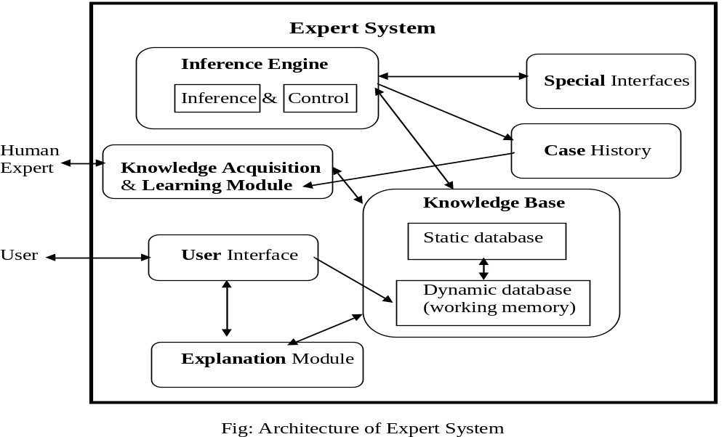
Expert System Architecture

Slide 6
Knowledge Base (KB)
KB consists of knowledge about problem domain in the form of static and dynamic databases.
Static knowledge consists of
  rules and facts which is complied as a part of the system and does not change during execution of the system.
Dynamic knowledge consists of facts related to a particular consultation of the system.
  At the beginning of the consultation, the dynamic knowledge base often called working memory is empty.
  As a consultation progresses, dynamic knowledge base grows and is used along with static knowledge in decision making.
Working memory is deleted at the end of consultation of the system.

Slide 7
Inference Engine
It consists of inference mechanism and control strategy.
Inference means search through knowledge base and derive new knowledge.
It involve formal reasoning involving matching and unification similar to the one performed by human expert to solve problems in a specific area of knowledge.
Inference operates by using modus ponen rule.
Control strategy determines the order in which rules are applied.
There are mainly two types of control mechanism viz., forward chaining and backward chaining.

Slide 8
Knowledge Acquisition
Knowledge acquisition module allows system to acquire knowledge about the problem domain.
Sources of Knowledge for ES
  text books, reports, case studies,
  empirical data and
  domain expert experience.
Updation of Knowledge can be done using knowledge acquisition module of the system.
  insertion,
  deletion and
  updation of existing knowledge

Slide 9
Case History
Case History stores the file created by inference engine using the dynamic database generated at the time of consultation.
Useful for learning module to enrich its knowledge base.
Different cases with solutions are stored in Case Base system.
These cases are used for solving problem using Case Base Reasoning (CBR).

Slide 10
Explanation module
Most expert systems have explanation facilities that allow the user to ask the system why particular questions, and how it reached to solution.
Explanation Module contains 'How' and 'Why' sub-modules.
  The sub-module ‘How’ tells the user about the process through which system has reached to a particular solution.
  ‘Why' sub-module tells that why is that particular solution offered.
It explains user about the reasoning behind any particular problem solution.
Questions are answered by referring to the system goals, the rules being used, and any existing problem data.

Slide 11
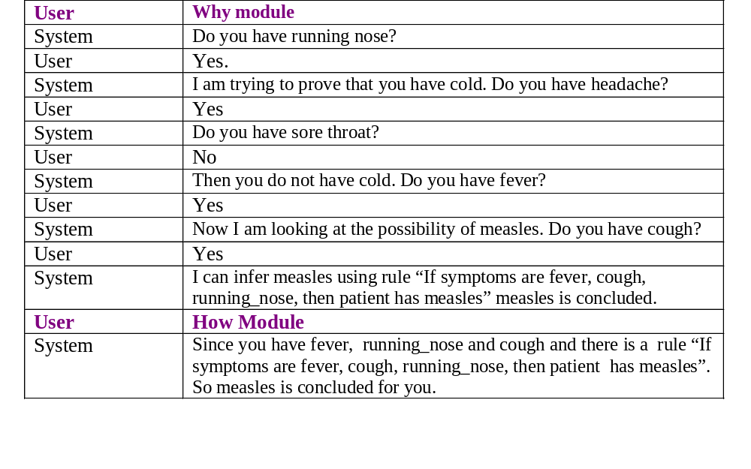
Explanation Modules Responses

Slide 12
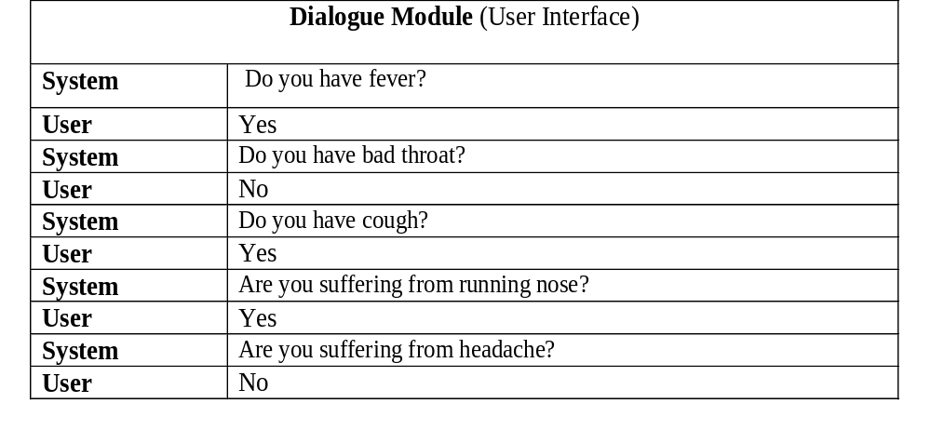
User Interfaces
Allows user to communicate with system in interactive mode and helps system to create working knowledge for the problem to be solved.

Slide 13
Special interfaces
It may be used for specialized activities such as handling uncertainty in the knowledge.
This is a major area of expert systems research that involves methods for reasoning with uncertain data and uncertain knowledge.
Knowledge is generally incomplete and uncertain.
To deal with uncertain knowledge, a rule may have associated with it a confidence factor or a weight.
The set of methods for using uncertain knowledge in combination with uncertain data in the reasoning process is called reasoning with uncertainty.

Slide 14
Rule Based Expert Systems
A rule based expert system is one in which knowledge base is in the form of rules and facts.
  Knowledge in the form of rules and facts is most popular way in designing expert systems.
It is also called production system.
Example: Suppose doctor gives a rule for measles as follows:
"If symptoms are fever, cough, running_nose, rash and conjunctivitis then patient probably has measles".
Prolog is most suitable for implementing such systems.
hypothesis(measles) :- symptom(fever), symptom(cough),
symptom(running_nose), symptom(conjunctivitis), symptom(rash).

Slide 15
Simple Medical diagnostic system with dynamic databases
The system starts with consultation predicate, that initiates dialog with user to get information about various symptoms.
Positive and negative symptoms are recorded in dynamic database and 'hypothesis(Disease)' is satisfied based on stored facts about symptoms.
If the hypothesis goal is satisfied then the disease is displayed otherwise display 'sorry not able to diagnose'.
Finally in both the situations, symptom database for a particular user is cleared.
Query: ?-consultation.

Slide 16
Medical Consultation System
consultation :- writeln(‘Welcome to MC System’), writeln(‘Input your name), readln(Name),
hypothesis(Dis), !,
writeln(Name, ‘probably has’, Dis), clear_consult_facts.
consultation :- writeln(‘Sorry, not able to diagnose’), clear_consult_facts.

Slide 17
Cont…
hypothesis(flu) :- symptom(fever), symptom(headache),
symptom(body_ache), symptom(sore_throat),
symptom(cough), symptom(chills),
symptom(running_nose),
symptom(conjunctivitis).
hypothesis(cold) :- ----------.
hypothesis(measles):- ----------.
hypothesis(mumps):- ----------.
hypothesis(cough) :- ----------.
hypothesis(chicken_pox):- ----------.

Slide 18
Cont…
symptom(fever) :- positive_ symp(‘Do you have fever(y/n) ?’, fever).
symptom(cough) :- positive_ symp(‘Do you have cough (y/n) ?’, cough).
symptom(chills) :- positive_ symp(‘Do you have chills (y/n) ?’, chills).
symptom(conjunctivitis):- -------.
symptom(headache):- -------.
symptom(sore_throat):- -------.
symptom(running_nose):- --------.
symptom(body_ache) :- --------.

Slide 19
Cont…
positive_ symp(_, X) :- positive(X), !.
positive_ symp(Q, X) :- not(negative(X)), query(Q, X, R), R = ‘y’.
query(Q, X, R) :- writeln(Q), readln(R), store(X, R).
store(X, ‘y’) :- asserta(positive(X)).
store(X, ‘n’) :- asserta(negative(X)).
clear_consult_facts :- retractall(positive(_)).
clear_consult_facts :- retractall(negative(_)).

Slide 20
Forward Chaining
Prolog uses backward chaining as a control strategy, but forward chaining can be implemented in Prolog.
In forward chaining, the facts from static and dynamic knowledge bases are taken and are used to test the rules through the process of unification.
The rule is said to be fired and the conclusion (head of the rule) is added to the dynamic database when a rule succeeds.
Prolog rules are coded as facts with two arguments, first argument be left side of rule and second is the list of sub goals in the right side of the rule.

Slide 21
Cont…
Represent prolog rule as a fact by rule_fact predicate and simple facts by fact predicate.
Consider the following Prolog rules and facts with their corresponding new fact representations.
    a :- b. ⇒ rule_fact(a, [b]).
    c :- b, e, f. ⇒ rule_fact(c, [b, e, f]).
    b. ⇒ fact(b).
    e. ⇒ fact(e).
    f. ⇒ fact(f).
  Here a, b, c, e, f are atoms (predicates with arguments, if any).
  Newly generated facts are stored in database file ‘dfile’ which is consulted in the prolog program.

Slide 22
Prolog Program with Forward Chaining
consult (‘dfile’).
forward :- finished, !.
forward :- fact(F),doall(rule(F)), assertz(used_facts(F)), retract(fact(F)), forward.
rule(F) :- rule_fact(L, R), rule1(F, L, R).
rule1(F, L, R) :- member(F, R), delete(F, R, NR),
new_rule(L, NR).
new_rule(L, [ ]):- not(fact(L)), asserta(fact(L)).
new_rule(L, R):- not(R = []), asserta(rule_fact(L, R)).
finished :- not(fact(X)).
doall(P) :- not(alltried(P)).
alltried(P) :- call(P), fail.

